Slide 1
6G4Z0024 Web Development Reading: Web Usability and accessibility
Yanlong Zhang
Y.Zhang@mmu.ac.uk

Slide 2
Usability and Accessibility
Usability and accessibility are essential considerations for web development
Usability = making a good user experience
“The ease with which users learn to use a web site,
how efficient they are when using it, how easy it is for them
to remember how to use it and how satisfied they are when they use it” (Jakob Nielsen)
Accessibility
Traditionally about making websites usable by people with disabilities
Now also about making websites accessible across different user devices
Can benefit search engine optimisation

Slide 3
Usability - why bother?
“Poor usability was one of the reasons many online companies went bankrupt in the infamous dot-com bust (1995-2000)”
Source: http://www.biquitous.com/how-crappy-usability-is-costing-you- sales
Every £1 invested in improving your website's usability returns
£10 to £100 (source: IBM)
A web usability redesign could increase visitors by 150% and sales/conversion rate by 100% (source: Jakob Nielson)
Radware.com research (2013) - 2-second delay in load time during a transaction resulted in abandonment rates of up to 87%
Users often leave Web pages in 10–20 seconds, but pages with a clear value proposition can hold people's attention for much longer” (Jakob Neilson, Sept 2011)

Slide 4
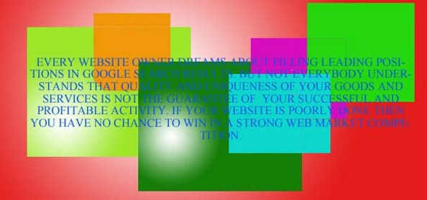
What makes good usability?
Understand your target audience and design with them in mind (gender, age, novice, expert, customer, casual browser, etc)
Good page design and structure
Professional look
Clear structure
Good use of headings
Page length
Image/text balance
Colour schemes

Slide 5
Primary factors (Jakob Neilsen)
Findability
How easily can users find the content they are looking for?
Information architecture, category names, headings, navigation, links
Information
Text, structure, images and other media
Intuitive Search
Easy to find, text field + button labelled “search” (ie like a search engine)
Page design
Layout, readability, graphics
A professional look helps build authority and trust

Slide 6
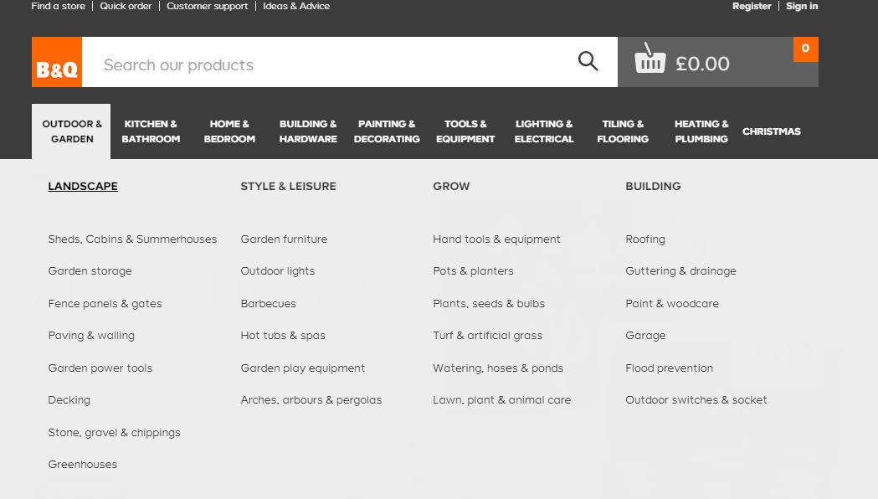
Navigation
Consistent across all pages – appearance and position
Easy to use/intuitive
Complex navigation clearly organised
Breadcrumb trails for complex sites
Styles for visited, active, etc

Slide 7
Other usability considerations
Text size and spacing
Typeface
Use conventions
FAQs, Contact Us, About Us, etc
Placing of content such as shopping basket, search, log-in/log-out, etc
Don’t underline text that isn’t a link
Use within-sentence links where appropriate (e.g. as Wikipedia does)
Good download times
Avoid gimmicks like scrolling text and flashing images

Slide 8

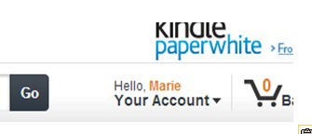
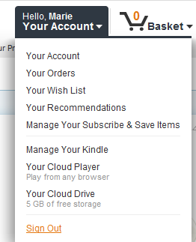
Intuitive functionality
Sign-in to Amazon is clearly visible
But signing out is not so obvious

Slide 9
Responsive design
A more recent usability consideration
Making your site work equally well on different devices (Example GitHub, Currys)
‘Simultaneous screening’ is increasing
Research by Google in 2012 showed
80% of participants use their smartphone whilst watching TV
66% had their smartphone available whilst using a desktop
90% started a task on one device and finished it on another

Slide 10
Accessibility

Slide 11
Accessibility – a legal requirement
Web accessibility is covered by the Equality Act
4.7 (p39): “From 1st October 1999 a service provider has to take reasonable steps to change a practice which makes it unreasonably difficult for disabled people to make use of its services.”
5.23 (p71): “For people with visual impairments, the range of auxiliary aids or services which it might be reasonable to provide to ensure that services are accessible might include ... accessible websites.”
5.26 (p68): “For people with hearing disabilities, the range of auxiliary aids or services which it might be reasonable to provide to ensure that services are accessible might include ... accessible websites.”

Slide 12
Disabilities that affect Web use
Poor vision / blindness
Poor hearing / deafness
Poor motor control
Memory impairment
Learning disabilities
There is a strong argument to suggest that by taking care of accessibility, you often improve usability

Slide 13
Understanding access issues
Video - Experiencing an inaccessible website
https://www.linkedin.com/learning/using-accessibility- to-improve-seo/experiencing-an-inaccessible-web- site?u=36102708
Video - Experiencing an accessible website
https://www.linkedin.com/learning/using-accessibility- to-improve-seo/experiencing-an-accessible-web- site?u=36102708

Slide 14
Good accessibility affects business
Good accessibility makes good financial sense
“10 million disabled people live in the UK with a combined annual spending power in excess of £80 billion. There are 54 million Americans with disabilities who have a disposable spending power of
$220 billion. “
http://businessdisabilityforum.org.uk/customer-experience/the- evidence#sthash.KUDzoo42.dpuf
Consider mild disabilities (e.g. colour blindness, poor eyesight, arthritis, dyslexia) and more serious disabilities (e.g. blindness)
Good accessibility can improve search engine optimisation (SEO)
Reap SEO Bonuses by Making Your Website Accessible
How Accessibility Helps SEO

Slide 15
Accessibility - implementation
Declare the language your page is written in
<html lang=“en”
dir=“LTR”>
Meaningful page <title>
Screen-readers announce the page title when first loading a page
Use heading levels to define information hierarchy
Use <em> and <strong> in html to emphasise important text for screen readers
<p>It is <em>very</em> important that you follow the instructions
<em>exactly</em>.</p>
<p>Before continuing with this exercise <strong> make sure you are wearing your safety glasses</strong>.</p>

Slide 16
Accessibility - implementation
Add a title attribute to hyperlinks, to provide more information about where the link goes
<a href=“http://www. scmdt.mmu.ac.uk” title=“Home page for Department of Computing and Maths”>Home</a>
Add ‘alt’ text attribute to images
<img src=“pr-face.jpg” alt=“Screenshot of a face coded in Processing software”>
Read by screen-readers
Displayed if image doesn’t load or is disabled (usability)
Provides semantic meaning which search engines can read (usability)
Add text descriptions/captions for video

Slide 17
Accessibility - implementation
Use lists for navigation menus
Don’t use images as text for headers (e.g. company banners)
For more information see Lynda.com tutorial on Improving SEO using Accessibility Techniques

Slide 18
Further accessibility considerations
Screen-readers can pick out link text, so make links user-friendly
For more information click here to send us an email For more information, send us an email
Use accessible fonts (e.g. sans serif such as Arial, Verdana)
Avoid using too many different fonts
For more on fonts http://webaim.org/techniques/fonts/#readability
https://www.boia.org/blog/best-fonts-to-use-for-website- accessibility

Slide 19

Alternative Style Sheets
Provide alternative style sheets
Different text sizes
Different colour contrasts (colour-blindness/dyslexia)
Accessibility on the BBC website

Slide 20
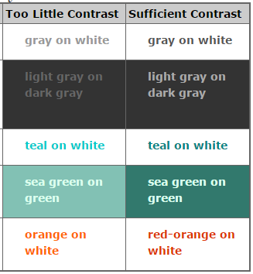


Colour and colour contrast
A big consideration for both usability and accessibility
Low contrast is not easy to read, for anyone
Colour-blindness can seriously impact on how pages look
AListApart – Contrast is King
What a colour-blind person might see

Slide 21
See examples of poor web design
There are websites dedicated to highlighting poorly designed websites. Some of the reasons are obvious, some are less so.
Elegentthemes.com blog
Web pages that suck
A particularly poor example is
Yale University School of Art

Slide 22
Further information
W3C Web Content Accessibility Guidelines (WCAG)
http://www.w3.org/standards/webdesign/accessibility
Ability Net – wide range of accessibility-related information and resources
http://www.abilitynet.org.uk/advice-info/web-accessibility- resources
Ecru web design agency explains the Equality Act 2010, web accessibility legislation in the UK, and considerations for different disabilities
http://www.ecru.co.uk/who-we-are/articles/why-is-web- accessibility-important-to-you.html

Slide 23
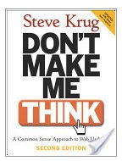
Further reading
Don’t Make Me Think by Steve Krug
Available electronically through MMU library catalogue
Usabilty.gov What & Why of Usability
Usereffect.com Checklist
25-point Website Usability
Improving website user experience

Slide 24
A note about referencing
If you are using online photos, or other resources, for your coursework, please reference them in your Word document
Use the Harvard Style
Manchester Met Guide to Harvard Referencing

